Slide 1


Introduction
JU info-graphic Map
TEAM : JUNEWBEE
Md. Tazel Hossan (1921)
Mushfika Munia (2319)
A multimedia Production
Manas Sarker Akash (2321)
Pallabi Biswas (300)
Kamelia Jaman Moon (299)
Tabia Tanzin Prema (309)
Umma Salma (302)

Slide 2

Member Roles
Md. Tazel Hossan
Dr. MD. Zahidur Rahman
Project
Manager
Producer
UI
Designer
Md. Tazel Hossan
Floor
Planner
Umma Salma
Kamelia Jaman Moon
A multimedia Production
Infographic
Designer
Mushfika Munia
Tabia Tanzin Prema
Photo
-grapher
Manas SarkerAkash
Pallabi Biswas

Slide 3


Our Objective
Creating a JU info-graphic Map
Jahangirnagar University
Dhaka Bangladesh
68%
An info graphic map is a visual representation of location
-based information. The objective of this project is to share
location-based information in a way that is easy for people
to understand.
Geography is sometimes a difficult concept for people to
visualize without a map to look at. It is created in such a
way that people can understand places relative to other
locations, especially if they have never heard of the place
being discussed
*Start in, December 2022
3

Slide 4


Tools
JUNEWBEE
Adobe XD
OpenStreetMap
Google Earth Studio
GitHub
Android Studio
Canva
GIMP

Slide 5
Our Working Cycle
Get a Picture
Design Floor Plan
Collect
&Design Map
Marge Them
Print Them
Step by Step Process

Slide 6
Work Progress
JUNEWBEE
Completed Task
We have collected the front view of all departments in JU.
We have collected floor planning's of CSE, Physics, Pharmacy, Social Science, Microbiology, Chemistry and Public
health buildings.
Next, we designed the infographics for these floorplans.
We collected each department's location using openStreetmap (coverage area 20m, captured from 50ft)
We made a generalized layout using Adobe XD. This layout has mainly 5 sections(map, front view of department,
floor plan, additional info, seat plan)
Finally, we have attached the infographics to this layout.

Slide 7
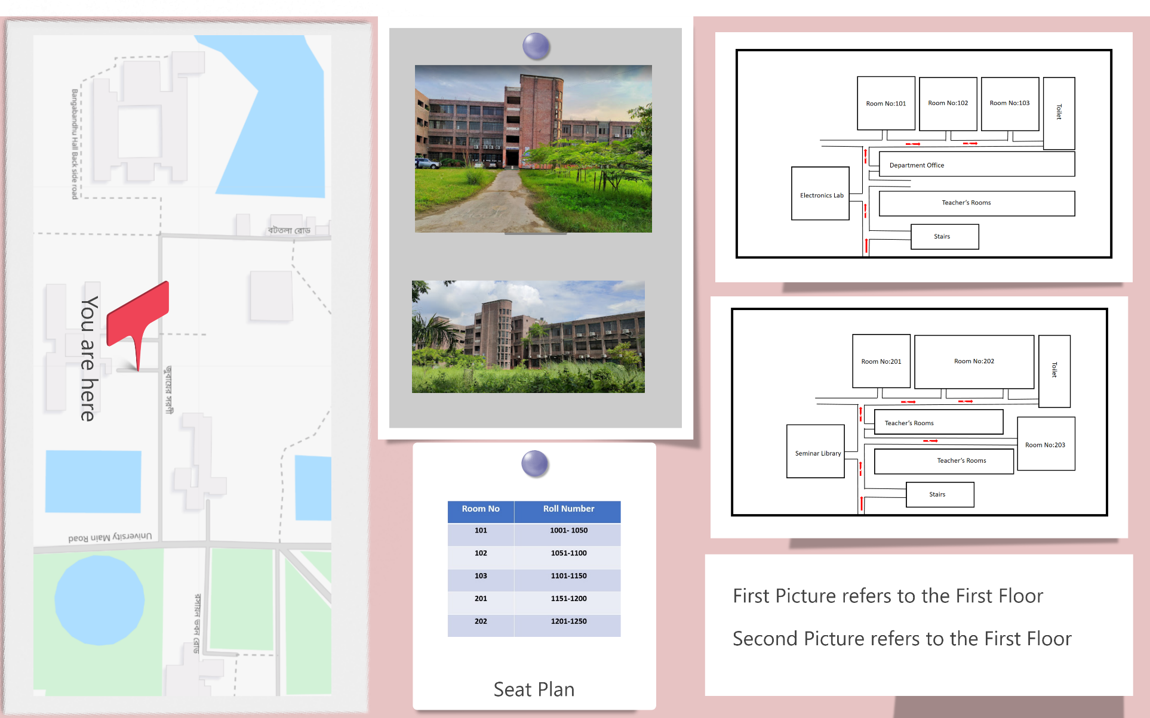
Work Progress

Slide 8
Hindrance That Faced So Far
Pined Points are
Installation problem in the environment (Adobe XD) for UI/UX design.
Face difficulties to show a full picture of JU map on a single image.
Problems arise to draw in paper of the architectural view of every floor. Because of complex perspective view.
Difficulties arise during floor planning design such as :
Good Floor Planning is difficult for some complex architecture in Jahangirnagar University (e.g. New Arts Building, Social Science).
b. Sometimes, complex architecture is hard to understand by viewing the floor plan for an outsider.
NO
It was difficult to capture a single clear image of the whole building of the department as there're trees or other objects in front of the building.

Slide 9
Next Week's Progress Proposal
JUNEWBEE
Target to complete
We will complete making info graphics for the rest of the departments.
Next, we will start designing our android app by 10th December. The app will show the info graphics searched by location.
Finally, we will develop the app by 15th December.

Slide 10
Gantt Chart
JU Info-Graphic Map 2022
Who
Task
Task
Task
Task
Task
Task
Task
Task
Everyone
Image Collection
Everyone
Floor Plan
Everyone
Map Design
Everyone
Android app design
Everyone
Andoid development
Everyone
App install
Everyone
Final Check
Everyone
Monitoring
Date
08/Dec./2022
09/Dec./2022
10/Dec./2022
11/Dec./2022
12/Dec./2022
13/Dec./2022
14/Dec./2022
15/Dec./2022

Slide 11
Thank You All
JUNEWBEE

